Slide 1

Supporting Social Relationships Through Nostalgia And Reminiscence
SOCIAL AND MOBILE COMPUTING: DECO3500
Team 12 - NO_PARKING!
Notes:
Hi all! We are Team 12 , and our team name is NO PARKING. Our project focuses on supporting relationships through nostalgia and reminiscence. We will be exploring what kinds of relationships these are, how people connect to memories, the objects that carry those memories, and more. Since this course is about Social and Mobile Computing, our focus is specifically on how people connect with or experience nostalgia together not just as an individual experience, but a shared one. To start, we spoke to tutors and students, and looked into existing research papers online, what kind of work has been done

Slide 2
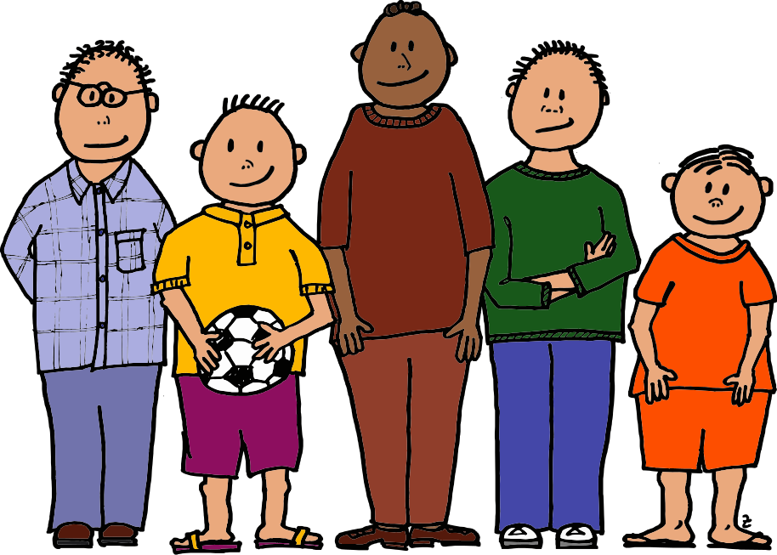
Who are we
Just a group of creative thinkers, working towards a goal.
Dong
Dev
Dattatray
Vim
Researchers
Shirish
Cross-disciplinary
Design Enthusiasts
Collaborative
Researchers
Human-centered
Strategic Clarity
Empathetic
Analytical
Notes:
Our combined, diverse backgrounds in law, business, market strategy and analysis, and design and now converging into IT, design, and research, will help us shape this experience understanding the space, digging into the why, identifying current gaps, and executing effectively for this course. We also bring strong visual and design backgrounds, alongside technical development experience. And since we're all in our final year, team coordination and mutual understanding should come naturally.

Slide 3




The Domain
Supporting relationships through nostalgia & reminiscence
Branches of Nostalgia
Personal vs Collective
Restorative vs Reflective
Social vs Sensory
WHY IT MATTERS
Recreative Curation
Digital VS. Physical asymmetry
Deliberately unopened memories
Contested Inheritance
Place-Triggered recall
Socially learned methods
Evidence: semi-structured interviews — age group between 20-60+
Notes:
Domain: We're looking at how people preserve and revisit memories, and how that affects their relationships and connection to their own past.
Why it matters:
- Reactive curation: nobody decides what matters upfront - they only sort it out once forced to, like running out of storage.
- Digital vs physical asymmetry: people hoard physical items because space feels endless, but delete digital memories constantly because storage runs out.
- Deliberately unopened memories: one interviewee kept a video of her grandmother she's never watched - preservation isn't always about wanting to revisit.
- Contested inheritance: some want to pass down objects, others explicitly want to pass down values instead - no consensus.
- Place-triggered recall: two interviewees independently described memories flooding back just from visiting a childhood location.
- Socially-learned methods: people are picking up preservation tricks like flower-drying from Instagram, not from family.
Evidence: Based on 3 semi-structured interviews across age groups - 60+, late 20s, early 20s.
Branches of nostalgia: personal (your own past) vs collective (shared cultural past); restorative (wanting it back) vs reflective (making peace with it); social nostalgia specifically tied to people, which ties back to our domain title; and sensory triggers as the practical entry point - smell, music, place, photos.

Slide 4
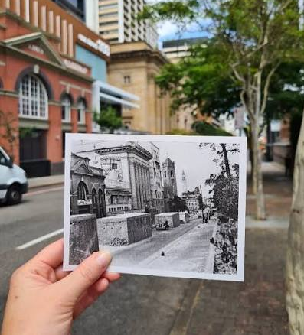
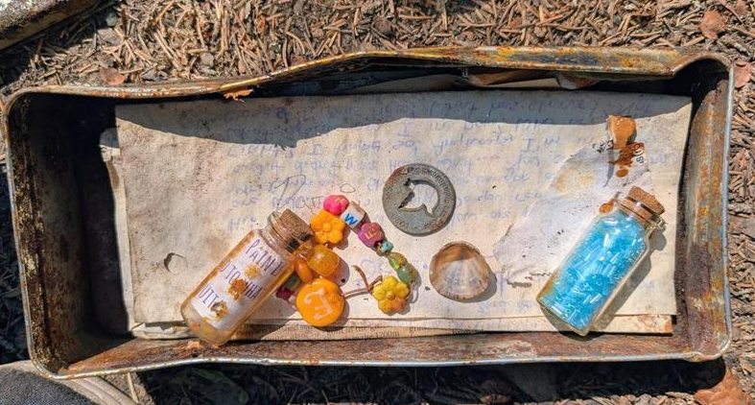
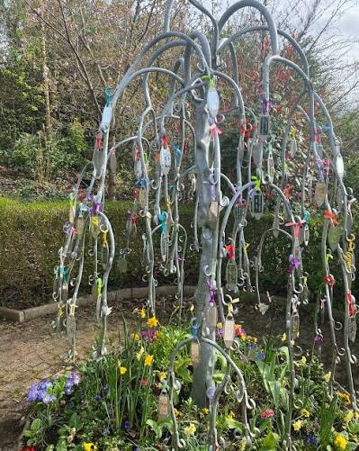
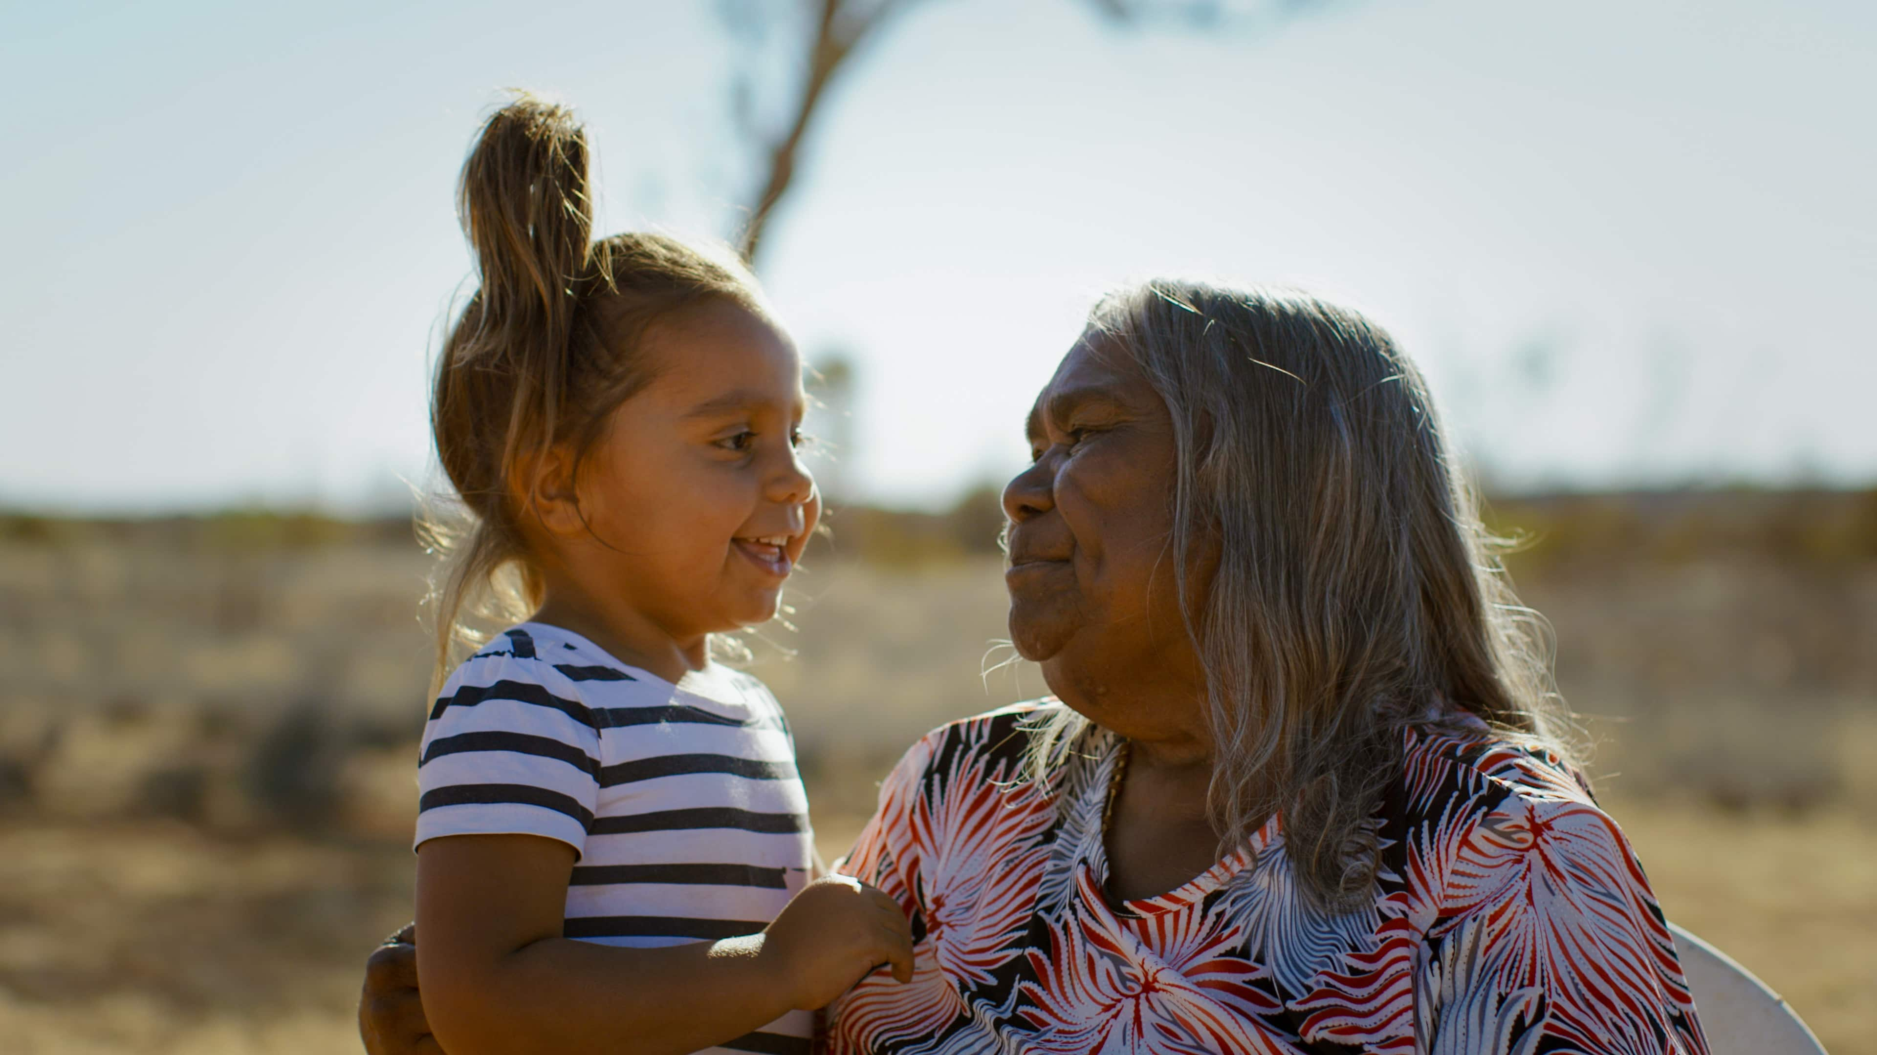

Design opportunities, concepts backed by research
What did it look like then?
Collective Audio Tree
Digital time capsule
Ancestral language preservation fragmented elder knowledge
People typically preserve memories through external artefacts like photographs, videos, and messages (Wardell & Palombo, 2024)
A memory lasts by emotional significance, identity relevance (Wardell & Palombo, 2024)
Memories can remain accessible for decades (Hirst et al., 2015)
Listeners in intergenerational storytelling are active participants who discover, decipher, and reconstruct fragmented stories, not passive recipients (Jones & Ackerman, 2018)
Autobiographical remembering serves ongoing psychological needs (Bluck et al., 2005;)
Compared to physical mementoes of memories, digitally created memories tend to feel less significant and forgotten easily (Petrelli & Whittaker, 2010)
Notes:
A shared audio capsule for a family or friend group. Each member records periodically (weekly/monthly). Individual recordings show up as living visual elements on a shared tree flowers glow when someone's doing well, leaves dim when someone's struggling. Once a year, at a "harvest" point, accumulated recordings crystallize into fruit a compiled memory of what the group grew through together.
1- Digital time capsule – time capsules are done among a group of friends of any age and mix to collectively preserve their memories in a container to revisit it after a certain agreed number of years. For example, a group of friends in a university, in their graduation party would get together and put some class notes, photos, notes to future selves, uni memorabilia, and various items into a container and bury it in a marked place and pledge to get together after 20 years to unearth it and cherish their memories. We want to extend this experience to have a mobile and digital experience given the challenges of full-physical time capsule like limited space to bury, rapidly changing landscapes and geographical distances of people from one another (friends).
2- What did it look like then? - People both locals and visitors alike often wonder how certain places looked like in the past and how it changed over the time. Photographic preservation of 'places' often happen spontaneously without intentional preservation for the future. Specially public places. For example - what did this house look like in 2015 might be a very difficult thing to visualise and refer, unless someone accidently took a picture then, often not archived. We want to explore a social collaboration which supports creating these memories by installing signals which reminds public to take a picture of the object and upload it to the identified destination in the public web. The signal, imagine a light installed on a lamp-post by the great-court at UQ would turn red on a given month annually which is the signal for somebody who walks by to take a picture and upload it to the memory time-line of the great-court.
Bluck, S., Alea, N., Habermas, T., & Rubin, D. C. (2005). A tale of three functions: The self-reported uses of autobiographical memory. Social Cognition, 23(1), 91–117. https://doi.org/10.1521/soco.23.1.91.59198
Conway, M. A. (2005). Memory and the self. Journal of Memory and Language, 53(4), 594–628. https://doi.org/10.1016/j.jml.2005.08.005
Hirst, W., Phelps, E. A., Meksin, R., Vaidya, C. J., Johnson, M. K., Mitchell, K. J., Buckner, R. L., Budson, A. E., Gabrieli, J. D. E., Lustig, C., Mather, M., Ochsner, K. N., Schacter, D. L., Simons, J. S., Lyle, K. B., Cuc, A. F., & Olsson, A. (2015). A ten-year follow-up of a study of memory for the attack of September 11, 2001: Flashbulb memories and memories for flashbulb events. Journal of Experimental Psychology: General, 144(3), 604–623. https://doi.org/10.1037/xge0000055
Jones, J., & Ackerman, M. S. (2018). Co-constructing family memory: Understanding the intergenerational practices of passing on family stories. Proceedings of the 2018 CHI Conference on Human Factors in Computing Systems. https://doi.org/10.1145/3173574.3173998
Petrelli, D., & Whittaker, S. (2010). Family memories in the home: Contrasting physical and digital mementos. Personal and Ubiquitous Computing, 14(2), 153–169. https://doi.org/10.1007/s00779-009-0277-7
Wardell, V., & Palombo, D. J. (2024). Stability and malleability of emotional autobiographical memories. Nature Reviews Psychology, 3(6), 393–406. https://doi.org/10.1038/s44159-024-00312-1

Slide 5
Audience & Prior Attempts
Who we're designing for, and what already exists
WHO WE'RE DESIGNING FOR
Groups with a shared endpoint — uni cohorts, sports teams, workmates, school friend groups
SKILLS
Phone-native. Already archive casually in camera rolls and group chats — but nobody owns the archive.
VALUES
Shared history over solo reflection. The group's story matters more than a polished record.
WORKFLOWS
Memory-keeping is spontaneous and scattered, only sorted out when storage runs out.
PRIORITIES
Low effort now, high payoff later. Wants a reason — and a date — to come back together.
WHAT ALREADY EXISTS
OpenItLater
Web only. Text messages that unlock on a set date
Timecapsule.com
Physical keepsake capsules sold as gifts
Capsuled
App. Sealed photo & video capsules, no edits once sent
PersonalCapsule
Private iPhone vault. Letters, photos, voice notes
Day One
Journalling app. Shared journals, but always open
Common pattern across all five: a capsule is sealed until a date, then authored and opened by one person.
Notes:
AUDIENCE
Our audience isn't defined by age bracket - it's defined by group shape. We're designing for groups that have a shared endpoint coming: a uni cohort about to graduate, a sports team at the end of a season, workmates before someone moves on, a school friend group that's about to scatter.
Beyond demographics:
Skills - they're phone-native and already archiving constantly, but passively. Camera rolls, group chats, shared albums. The material exists; nobody owns it or curates it.
Values - what they care about is the shared history, not the individual record. This is why solo journalling doesn't scratch the itch. The story matters because other people were in it.
Workflows - memory-keeping happens spontaneously and lives scattered across WhatsApp, Instagram and camera rolls. From our interviews, it only gets sorted out reactively, usually when storage runs out.
Priorities - they'll accept almost no effort at the time in exchange for a big payoff later. And they need a reason and a date to come back to it, otherwise it just sits there.
PRIOR ATTEMPTS
We looked at the five closest things already in the market.
OpenItLater is web-only and text-only - you write a message, set a date, it unlocks. You can share the link, but the content is one person's.
Timecapsule.com isn't digital at all - they sell physical keepsake capsules as gifts.
Capsuled is a mobile app: sealed photo and video capsules with a countdown, and once it's sealed you can't edit it. You send it to friends or followers.
PersonalCapsule is explicitly private and solo - an iPhone vault for letters, photos and voice notes to your future self.
Day One is the closest on the social side - it added Shared Journals in 2024 - but it's continuous journalling, always open, with no seal-and-return moment.
The common pattern across all five: a capsule gets sealed until a date, but it's authored and opened by one person. That's the shape of the space as it stands today.

Slide 6
Plan of Work & Methods
What we still need to find out, and how we'll investigate it
STILL TO FIGURE OUT
HOW WE'LL INVESTIGATE IT
Which concept direction fits real groups
Nostalgia vs. reflective-memory framing
Will groups commit to a future “vow to return”?
How our gap differs from existing solo-focused tools
Competitor teardown (3 existing tools)
User interviews across group types
Converge on one concept direction
Low-fidelity prototype + small test
TIMELINE
Wk 5–7
Wk 7–8
Wk 9
Wk 10–12
Wk 13
Interviews + converge on concept
Requirements + low-fi prototype
Stand-up: research, prototype, first testing
Build + refine, prep poster/pitch
Final documentation submitted
Notes:
Still to Figure Out
Which concept direction fits real groups
We have several variations on the table at the moment, like a simple digital time-capsule, digital memory bubble, house stories, NFC tags to access memories, Digital memory museum, Digital reunion, etc.
We as a group don’t yet know which one actually resonates with people vs which one sounds interesting to them
Nostalgia vs. Reflective-memory
our research lead to an important distinction
Do individuals look back fondly for the nostalgia or do they grow from a memory and reflect
Both can lead to different design
Need to find out which framing our target audience want
Will group of people commit to the “vow to return”
This is the core concept of our domain topic but not tested
Does shared future date get honoured in real life? Or does it become something groups abandon
How our gap differs from existing solo-focused tools
Several existing time capsule apps already exist as mentioned before, but most appear for individual use.
Research and understand why no one has built a group version yet.

